Slide 1

Revenue analysis & Inventory management
Capstone project by Subhasish Halder

Slide 2
AGENDA
Objectives
Background
Key Findings
Recommendations
Appendix
Data Source
Date Methodology
Data model assumptions
Executive Summary

Slide 3
OBJECTIVES
Find areas of improvement in inventory management
Find top products that contribute to the revenue of Olist
Perform Market Basket Analysis to understand the purchase behavior of individual customers
Identify products that are moving in combination with other revenue generating products
Identify low performing product categories.
Identify areas to reduce losses, improve sales & revenue generation.

Slide 4
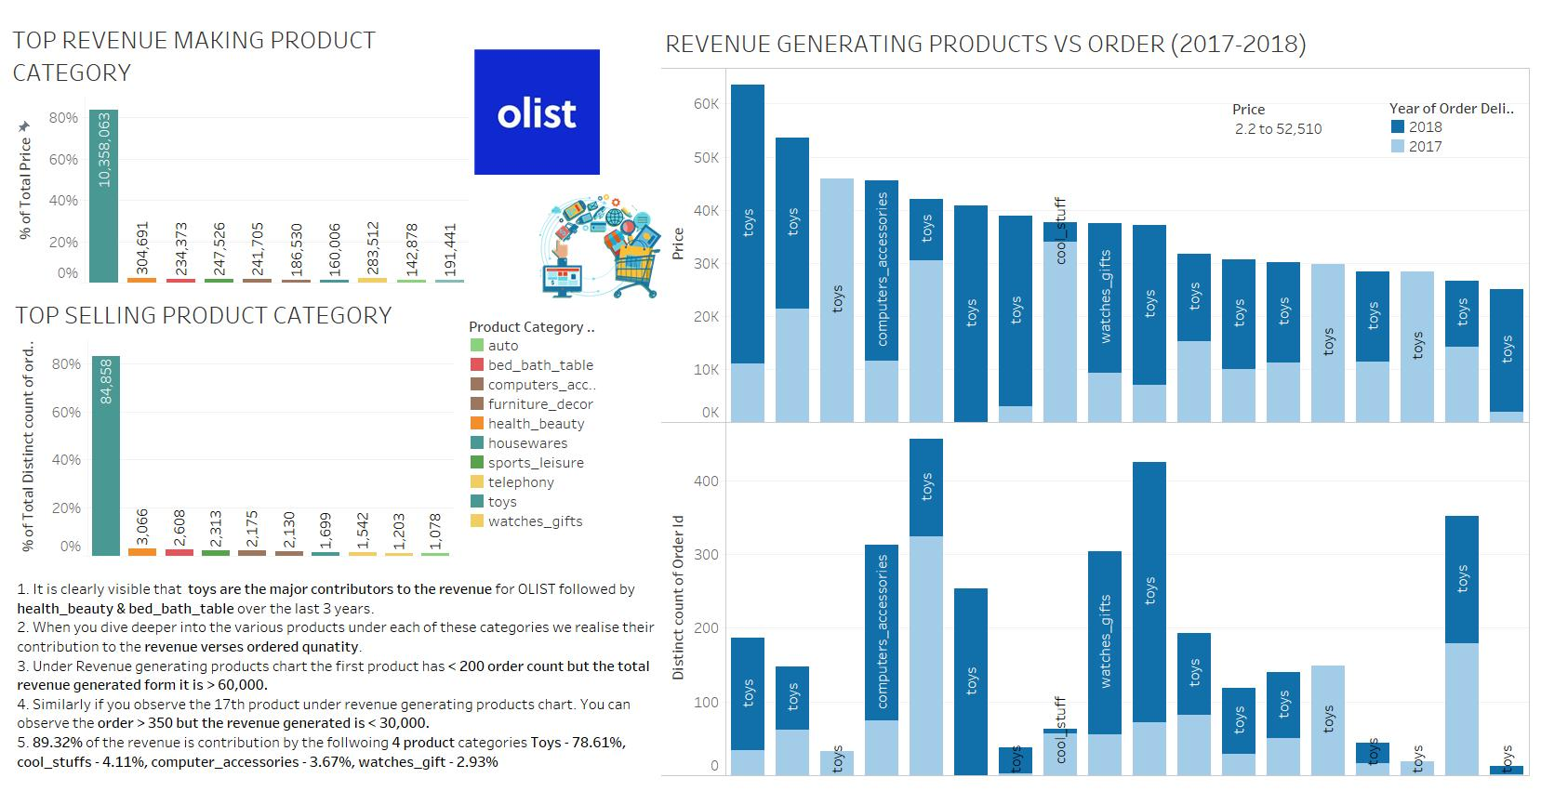

Slide 5
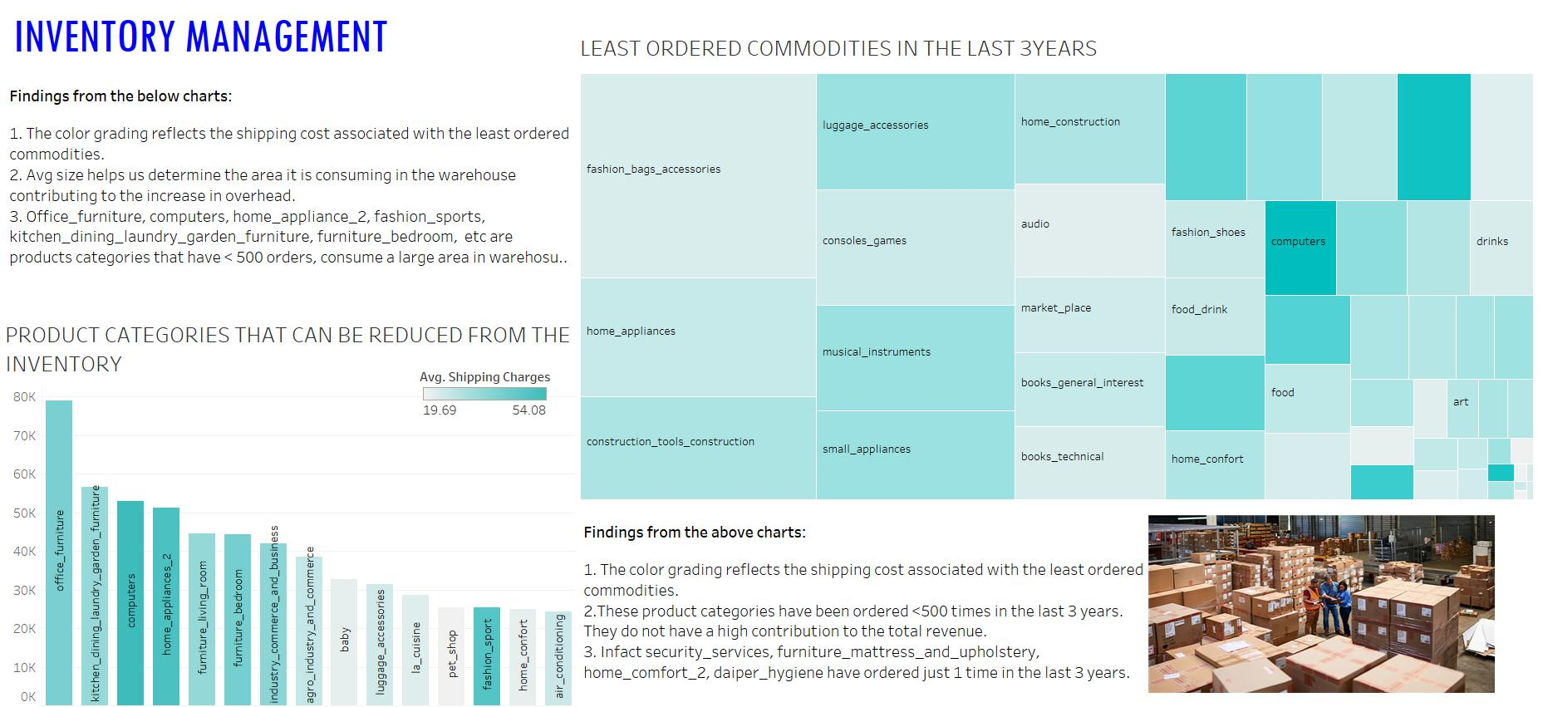

Slide 6
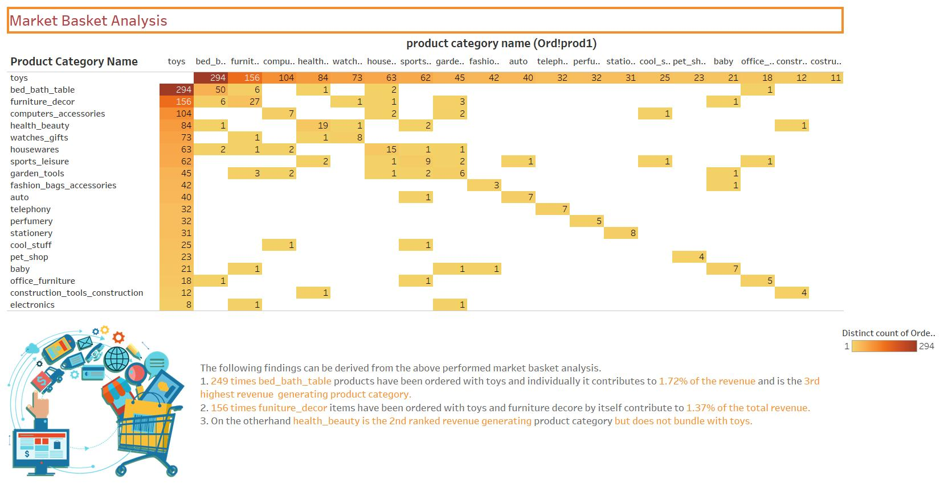

Slide 7
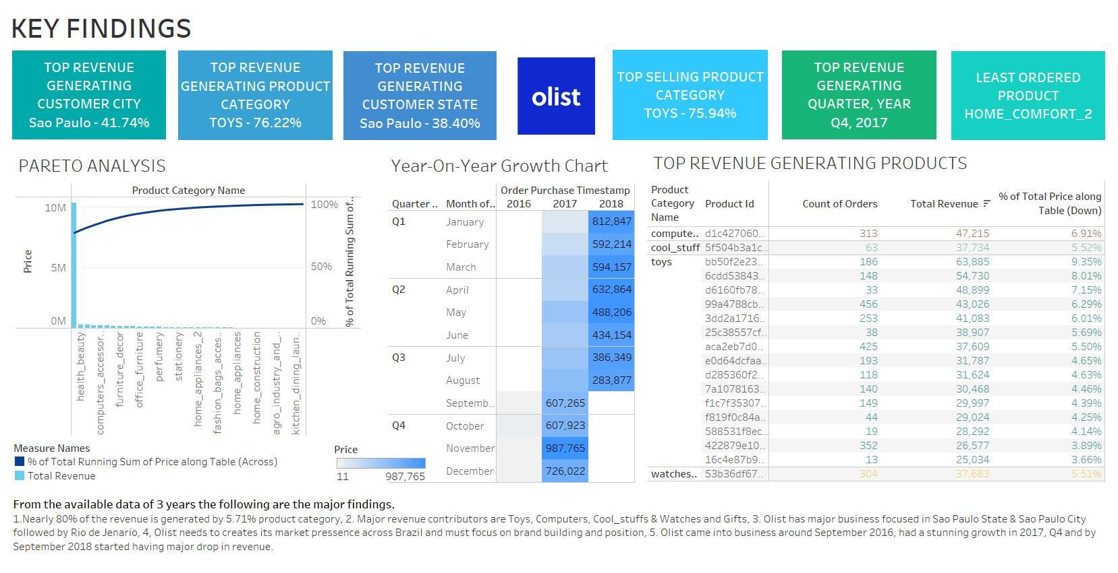

Slide 8
RECOMMENDATIONS
Bed_bath_table & furniture_ décor are the 2 product categories that can be clubbed with toys to increase their sales, offers & discounts can be formulated to attract customers.
Non-performing product categories like office_furniture, home_appliance_2, fashion_sports, furniture_bedroom, kitchen_dining_laundry_garden_furniture, security_services, furniture_living_room, agro_industry_and_commerce, luggage_accessories, furniture_mattress_and_upholstery, home_comfort_2, daiper_hygiene, fashion sports, signaling and securities etc can be moved out of the inventory stock to reduce unnecessary loss.
Major focus should be diverted to the 80% revenue generating product category such as toys, computers, cool_stuffs, watches_gifts, health_beauty, computer_accessories, etc.
Top performing Sellers products should be given more offers and benefit to encourage their involvement.
Geographical presence across the major states & cities in Brazil should be undertaken for better customer reach. There is a huge market gap between Sao Paulo and other states as well the cities. This gap needs to be addressed through marketing campaigns and offers for tier 2 city customers.
Customer loyality programs needed to incorporated to have repeat business.

Slide 9
Appendix
Data Source used by the team:
Retail_dataset by Olist, Brazilian e-commerce company with a data period starting 2016-2018.
Dataset had 5 sheets. The entire dataset contained 11 numerical variables
A new sheet was created using Order_items table & Products table named as Ord_prod to perform Market Basket Analysis.
Data Methodology:
A basic layout for the final presentation answering the project required was sketched.
Data cleaning was performed in Jupyter notebook using python libraries.
Duplicate values were checked, Under orders table only "DELIVERED" orders have been considered for this analysis.
Orders table has a few missing values, though a negligible amount it was imputed with most appropriate data available.
Under Customers table, customer_id had a few duplicates and the same were dropped.
There were around 170 missing values of product category, again a negligible quantity as compared to the volume of data available. Nevertheless, we filled it with the most recurring product category which was 75% of all categories.

Slide 10
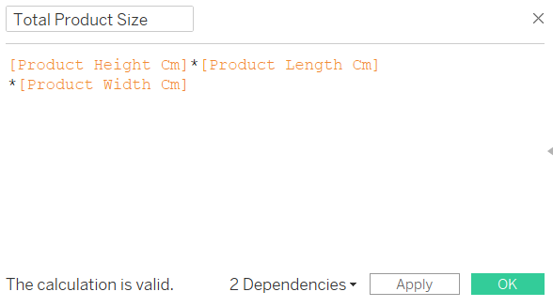
Appendix
Data Methodology:
There were 4 other variables in the Product table with missing values of 2 each when checked it was all part of the same row in the products table. hence decided to drop it.
The sheets were then saved and exported to a new cleaned excel file for further analysis.
Calculated field was generated to study the area consumed by the products.
Market basket analysis was performed on a separate tableau file using the newly created ord_prod table to study the purchase correlation between the product categories.
Data Model Assumption:
Only data with “delivered” status has been used for the analysis.
The Outliers are assumed to form an integral part of the data analysis hence has not been treated.

Slide 11
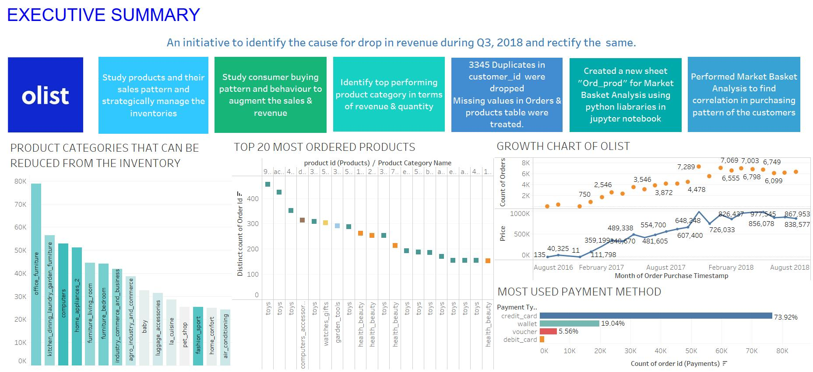

Slide 12
Executive summary - i
We start off the things by data cleaning and understanding. In the data we have 5 sheets, viz, orders, order_items, customers, payments and products. For each sheet data was treated and read with the help of python libraries.
Orders- No duplicate values, orders with order_status as ‘delivered’ were filtered, missing values of timestamps were imputed as per the requirement, no outliers detected
Order items – No missing values, No duplicate values, Outlier treatment not done as may lead to data loss
Customers- No missing values,Duplicate customer id’s were dropped, no ouliers detected
Payments- No missing values, duplicate order id’s were dropped outlier treatment not done as may lead to data loss
Products – Missing values for product category name imputed with Mode, product weight with Median, product height, length, width with mean, no duplicate values
After the complete treatment the cleaned data was exported to Retail_dataset_cleaned excel file as the same manner

Slide 13
Executive summary - ii
For the market basket analysis we need to form a different dataset by a combination of products table and order_items table.
We do this with the help of excel power query editor by forming an inner join between the two tables and fetching out the required columns. Then this newly generated table is exported as a new dataset : Market_Basket_Dataset
For the visualization purpose we use tableau for gathering insights about different products and product categories as well as for the market basket analysis
We found the top 20 products both by revenue and order quantity, Top 25% products and their contribution in the revenue as well as quantity separately, average price and shipping charges for different product categories, total orders per product category, pareto analysis and market basket analysis for both single category as well as combination of 2 categories.

Slide 14
Thank you !

